Slide 1
Cloud Prototyping SS19
Decentralized Energy Trading
Midterm Presentation

Slide 2

Table of Content
Motivation
Current implementation
Household processing unit
Blockchain
dUtility contract
Live demo
Evaluation
Next steps

Slide 3




Motivation
EEG Umlage
Notes:
Current setting
Several actors: different Consumer, Prosumer
Prosumer sells energy to Utility with EEG Umlage
Consumer buys energy from Utility

Slide 4
Motivation
EEG Umlage
Notes:
EEG Subvention will be cut from 2020 on

Slide 5

Motivation
Notes:
Using solar panels will not be profitable for most households

Slide 6

Motivation
Notes:
Solution: Ethereum Blockchain as decentralized energy market
Proof of Authority Consensus
Households can trade energy with each other
Energy Utility is only used when Produced energy < Consumed energy
Makes solar panels profitable again

Slide 7
Current implementation

Slide 8

Architecture
Sensor
Sensor
Sensor
Data
Stream
Smart Meter
Notes:
We explain it along the data stream
Sensors of solar panel and energy consumption stream the data to hhs
Encapsulated as a smart meter
Send data periodically (currently every 30s)
Add component that signs the sensor data

Slide 9
Architecture
Household JS-Server
Sensor
Sensor
Parity Client
Sensor
Data
Stream
Database
User Interface
Smart Meter
Household Processing Unit
Notes:
NodeJS Server with Express.js as universal middleware
MongoDB to store Sensors Data (and Blockchain Data, explained later)
User Interface for Displaying Data to the user, data from Database via HHS
Parity Client as Interface to the Blockchain
Access to Blockchain

Slide 10
Architecture
Collecting Energy Transfer Receipt
Household JS-Server
dUtility
Sensor
Consume/Produce
Transactions
Lock/Unlock
Account
Sensor
Parity Client
Trigger Netting
Sensor
Validator Set
Data
Stream
Database
User Interface
Smart Meter
Household Processing Unit
Ethereum Blockchain
Notes:
Ethereum Proof of Authority Blockchain
Built on Parity
Smart Contracts
Validator Set
Settlement
Gas price for netting
Block rate → netting every 5 blocks

Slide 11
NEtting Algorithm
Notes:
Two household groups. In this case more consumed than produced
we ensure that one household group (in this case the Producer)
we can guarantee to fulfill everyone's request

Slide 12
NEtting Algorithm
Notes:
because we want that all producing household's get a appropriate cut from the cake, every producing household shares their percentage of contribution to the system applied to the total amount of energy needed.
In this case, hh1 contributed 66% to the system so they get share 66% of 200 = 132 amount of energy spread to all households in a FIFS manner (time of household added)

Slide 13
NEtting Algorithm

Slide 14
NEtting Algorithm

Slide 15
NEtting Algorithm

Slide 16
Live Demo
Notes:
Live Demo of the current setup. Approximately 10 Minutes

Slide 17
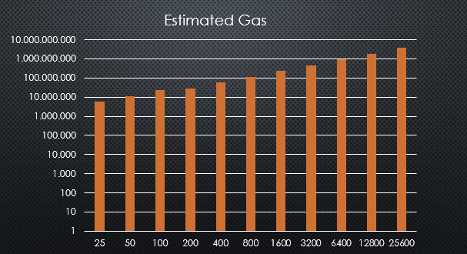
evaluation
Notes:
Current evaluation:
Strengths
Weaknesses

Slide 18
evaluation
Strengths
Decentralized System
Weaknesses
Events not observable in Block Reward Contract
Not privacy-aware
Gas limitation
Notes:
TODO

Slide 19
Next Steps
Privacy
Zero-knowledge Proofs
→ Hawk
→ ZoKrates
UI/ UX improvements
Notes:
Zero-knowledge proofs
One party proves to another party that a transaction is true without revealing details about the specific transaction
Implementation by complex cryptographic methods
allows verification of transactions without revealing identities
suitable for our requirements
Hawk
Smart contract system encrypting transactions on the blockchain
Relies on zero-knowledge proofs
No off-chaining → no benefit of cost or performance
No stable version released by now
ZoKrates
toolbox using and providing zero-knowledge proof methods
also allows off-chaining of computational steps → cost and performance benefit possible

Slide 20
Questions?

Slide 21
Household processing Unit
NodeJS Server with Express.js
MongoDB
Sensors Data
Blockchain Data
User Interface
Displaying Data
Parity Client
Access to Blockchain
Notes:
Not sure if displaying the HHUnit is good here. Looks too crowded.

Slide 22
Blockchain
Ethereum Proof of Authority Blockchain
Built on Parity
Smart Contracts
Validator Set
Settlement

Slide 23
evaluation
Notes:
Current evaluation:
Strengths
Weaknesses

Slide 24
Next Steps
Signing the sensor-data
Make system privacy aware

